Slide 1

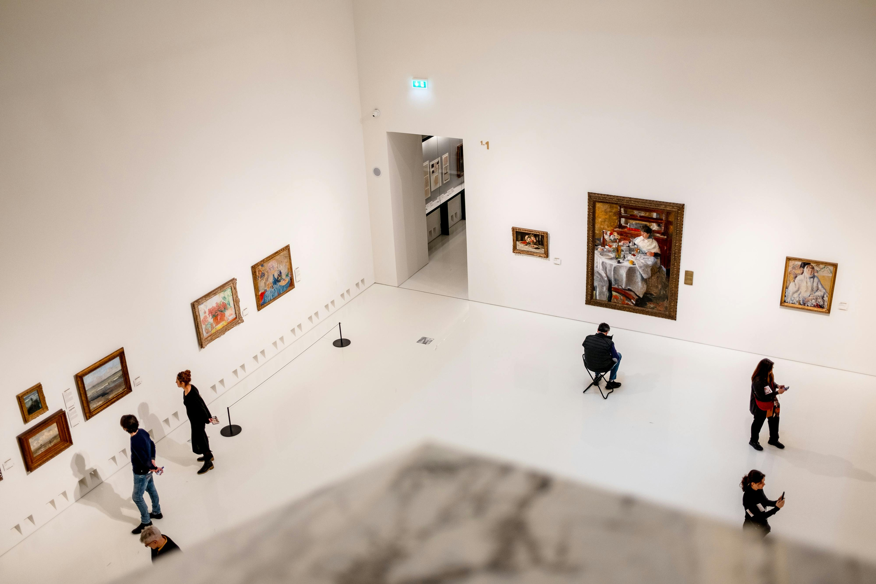

Redefining Public Access to the Forbidden City
HAO XUANYING
HY5419

Slide 2
CONTENT
■ Research Problem
■ Why?
■ Dataset
■ Project Design
■ Current Progress
■ Challenge

Slide 3
PART
01. Research Problem
ONE
And Why the Yangxin Dian?

Slide 4

Research Problem
Pilot Case: The Yangxin Dian, 2015–2025
How has the Palace Museum used physical and digital space to redefine public access to the Forbidden City since its establishment in 1925?

Slide 5
Why the Yangxin Dian?
2015.10.8
2015.12.18
2025.12.26
During Closure......
Closed to the public for conservation
Research-based conservation project launched
Reopened to the public
  Documentaries
  travelling exhibitions
  digital experiences
■ A documented change in access

Slide 6
PART
02. Dataset
TWO
& Project Design

Slide 7
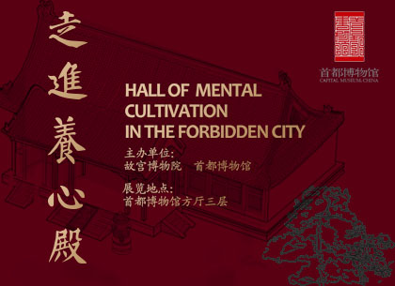
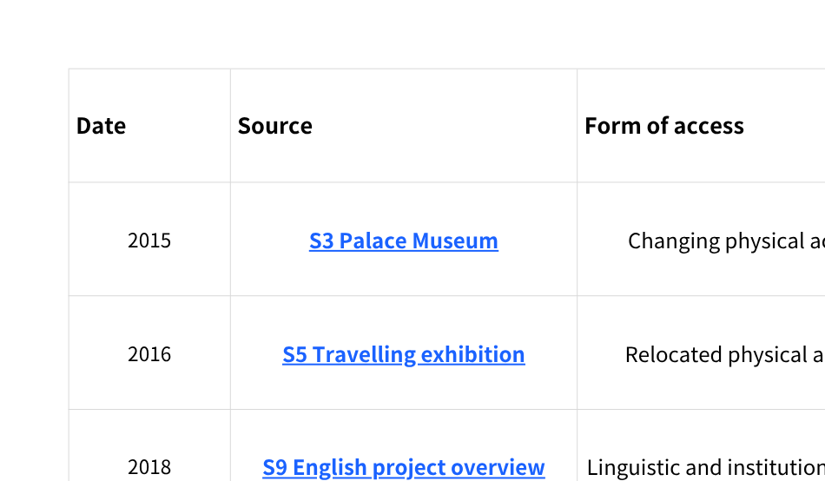
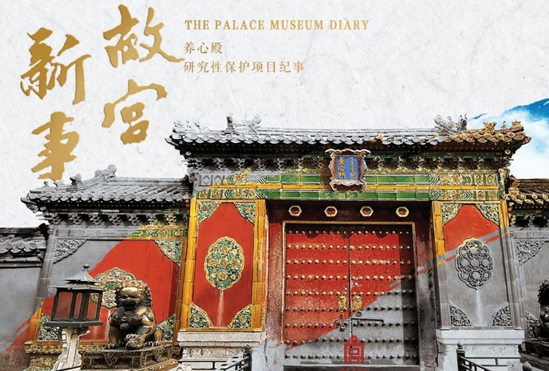
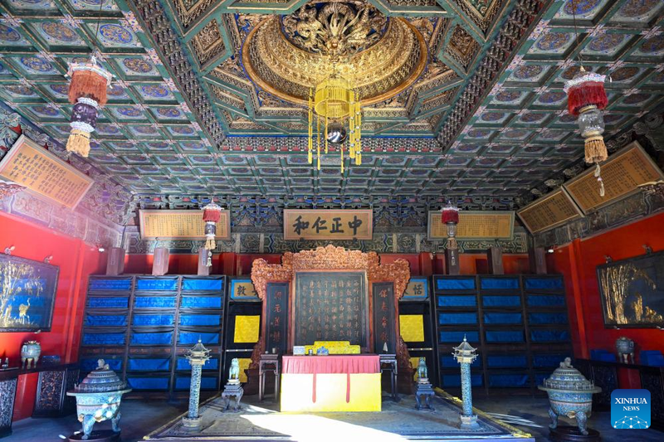
Dataset

Slide 8
PART
03. Current Progress
THREE
& Challenge

Slide 9
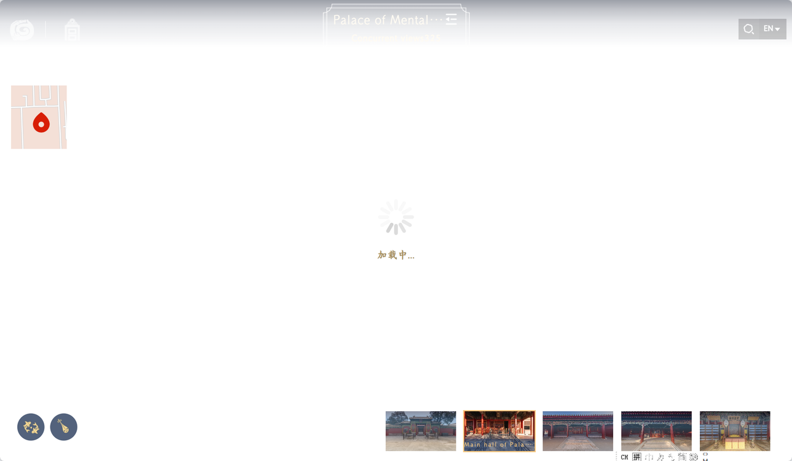
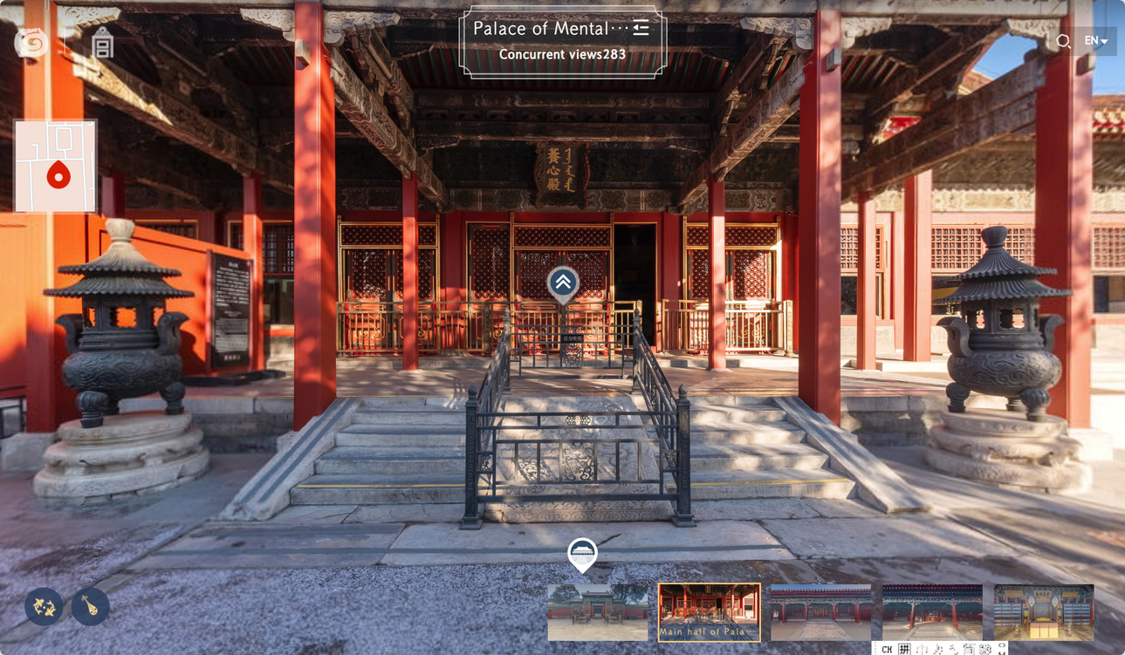
Testing Digital Access
  Can the user enter the platform?
  What can the user see?
  What can the user understand?
Researcher walkthrough, 15 September 2026

Slide 10
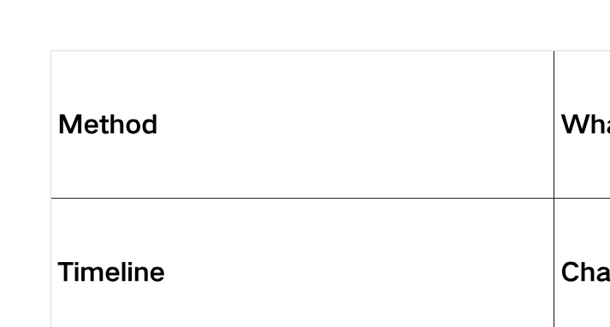
Challenge

Slide 11
Challenge
  Is this framework sufficient for comparing different forms of access?
  Should the project remain focused on institutional mediation, or should I add visitor evidence?

Slide 12
Resources
  S3. Palace Museum. “故宫博物院养心殿研究性保护项目启动系列活动在端门数字馆举行” [Launch Events for the Research-based Conservation Project of the Hall of Mental Cultivation]. 18 December 2015.
  S5. Palace Museum. ““走进养心殿展”在首都博物馆开幕” [“Entering the Hall of Mental Cultivation” Exhibition Opens at the Capital Museum]. 30 September 2016.
  S9. Palace Museum. “Major Progress in the Hall of Mental Cultivation (Yangxin Dian) Research and Conservation Initiatives.” Exhibition, 10–31 August 2018.
  S11. Palace Museum. “《故宫新事》——养心殿研究性保护项目纪事第三集线上发布” [Palace Diary: Documentary on the Research-based Conservation of the Hall of Mental Cultivation, Episode 3]. 19 July 2019.
  S12. Palace Museum. “关于养心殿重新开放的公告” [Announcement on the Reopening of the Hall of Mental Cultivation]. 23 December 2025.
  S13. Xinhua. “China Focus: To Its Original Glory, Palace Museum Reopens Key Section after a Decade of Restoration.” 26 December 2025.
  Palace Museum. “全景故宫” [Panoramic Palace Museum]. Interactive website. Accessed 15 September 2026.
  Palace Museum. “202510—午门—秋季.” Palace Museum Wallpaper. Accessed 15 September 2026.
  Capital Museum. “走进养心殿” [Entering the Hall of Mental Cultivation]. Exhibition, 27 September 2016–26 March 2017. Photography credit: 朴识.
  Palace Museum. “视听馆” [Audio-Visual Gallery]. Accessed 15 September 2026.
  Xinhua. Images accompanying “China Focus: To Its Original Glory, Palace Museum Reopens Key Section after a Decade of Restoration.” Photographs by Jin Liangkuai, 25 December 2025.
  Palace Museum. “全景故宫” [Panoramic Palace Museum]. Accessed 15 September 2026.

Slide 13
THANK
Thanks for listening!
YOU
And I’m looking forward to your review;)

